Slide 1
Data Manipulation (1)
Programming for Data Analysis (CT127-3-2-PFDA and Version VC1)

Slide 2
Topic & Structure of the lesson
Tibbles
Pipes
dplyr package
filter function
arrange function
select function
mutate function
summarise function
group_by function
Using combination of these functions

Slide 3
Learning outcomes
At the end of this topic, you should be able to:
Understand how to solve most data manipulation challenges.

Slide 4
Key terms you must be able to use
If you have mastered this topic, you should be able to use the following terms correctly in your assignments and exams:
Tibbles
Pipes
Data manipulation using dplyr package

Slide 5
1
Data Manipulation?

Slide 6
Data Manipulation
Many process can be made to make the data a little easier to work with includes:
Narrowing in on observations of interest (like all products produced in the last year)
Creating new variables that are functions of existing variables (like computing net income from the gross income, taxes and other deductions).
Calculating a set of summary statistics (like counts or means).
Adding, updating, or removing data.
Reorder the observations.

Slide 7
2
Tibbles

Slide 8
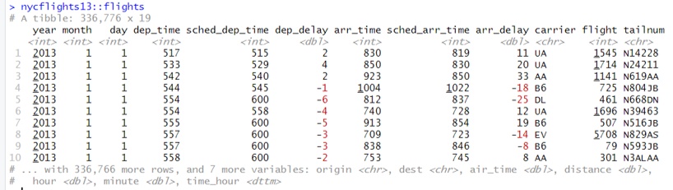
Tibbles
Tibbles are data frames, but they tweak some older behaviors to make life a little easier
Tibbles vs. data.frame
Printing: Tibbles shows only the first 10 rows, and all the columns that fit on screen.
Subsetting: [ always returns another tibble. Contrast this with a data frame: sometimes [ returns a data frame and sometimes it just returns a vector.

Slide 9
3
Pipes

Slide 10
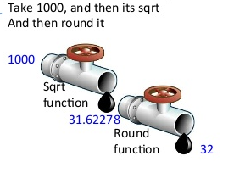
Pipes
A new paradigm for calling functions in R is the pipe.
The pipe from the magrittr package works by taking the value or object on the left-hand side of the pipe and inserting it into the first argument of the function that is on the right-hand side of the pipe.
Pipes are most useful when used in a pipeline to chain together a series of function calls.
x=sqrt(1000)
round(x)
round(sqrt(1000))
library(magrittr)
1000 %>% sqrt %>% round
https://www.slideshare.net/Ram-N/data-manipulation-using-r-acm2014

Slide 11

4
dplyr package

Slide 12
dplyr package
dplyr is a grammar of data manipulation.
The following functions help you to solve the vast majority of your data manipulation challenges:
filter function: to pick observations by their values.
select function: to pick variables by their names.
arrange function: to change the ordering of the rows.
mutate function: to create new variables with functions of existing variables.
summarise function: to reduce many values down to a single summary.
group_by function: to change the scope of each function from operating on the entire dataset to operating on ‘by group’.

Slide 13
5
Extract Cases using filter function

Slide 14
Using filter function
filter(.data, ...)
the name of the data frame
the expressions that filter the data frame
library(dplyr)
data(flights, package="nycflights13")
filter(flights, month == 1, day == 6)
flights %>%
filter(month == 1, day == 6)

Slide 15
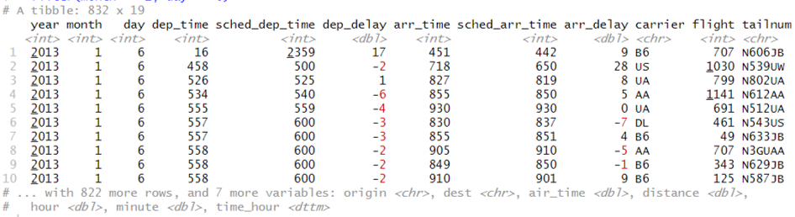
Using filter function
library(dplyr)
data(flights, package="nycflights13")
filter(flights, month == 1, day == 6)
flights %>%
filter(month == 1, day == 6)

Slide 16
6
Extract Variables using select function

Slide 17
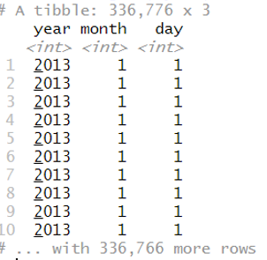
Using select function
select(.data, ...)
the name of the data frame
the expressions to keeps only these variables
library(dplyr)
data(flights, package="nycflights13")
select(flights, year, month, day)
flights %>%
select (year, month, day)

Slide 18
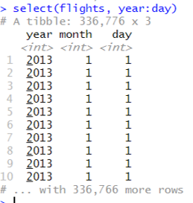
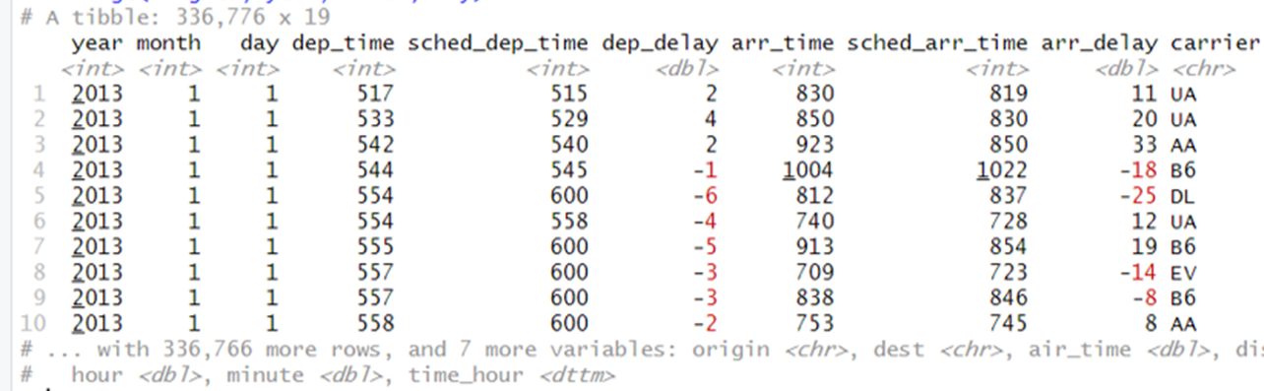
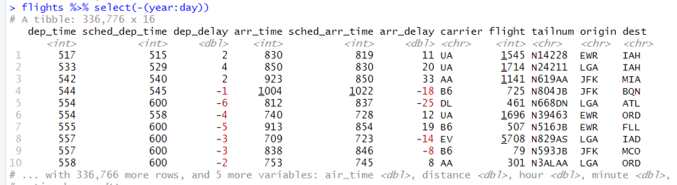
Using select function

Slide 19
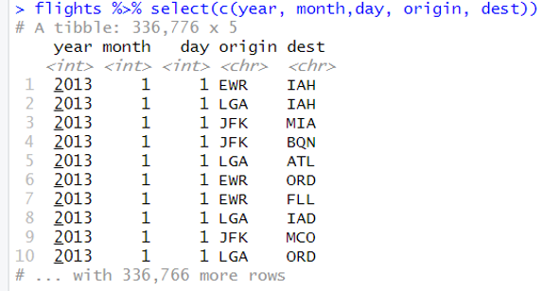
Using select function

Slide 20
7
Arrange Cases using arrange function

Slide 21
Using arrange function
arrange(.data, ...)
the expressions to arrange the data
Use desc() to sort a variable in descending order.
the name of the data frame
library(dplyr)
data(flights, package="nycflights13")
arrange(flights, year, month, day)
flights %>%
arrange(year, month, day)

Slide 22

Using arrange function
library(dplyr)
data(flights, package="nycflights13")
arrange(flights, year, month, day)
flights %>%
arrange(year, month, day)

Slide 23
8
Make New Variables using mutate function

Slide 24
Using mutate function
mutate(.data, ...)
the name of the data frame
New variables
library(dplyr)
data(flights, package="nycflights13")
flights_sub <- select(flights, year:day,distance, air_time, origin, dest)
flights_sub<-mutate(flights_sub, speed = distance / air_time * 60)
flights %>%
select(year:day,distance, air_time, origin, dest) %>%
mutate(speed = distance / air_time * 60)

Slide 25
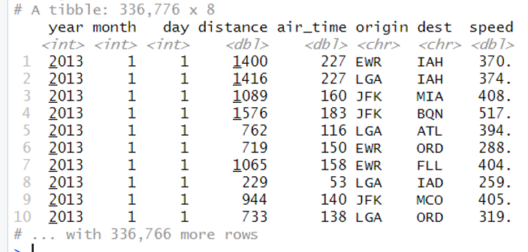
Using mutate function

Slide 26
9
Summarize cases using summarise function

Slide 27
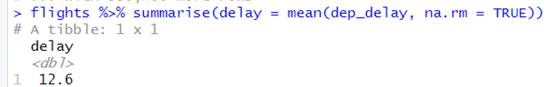
Using summarise function
summarise(.data, ...)
the name of the data frame
summary functions
Some useful functions: mean(), median(), min(), max(), first(), last(), n(), n_distinct(),…

Slide 28
10
Group cases using group_by function

Slide 29
Using group_by function
group_by(.data, ...)
the name of the data frame
groups
by_dest <- group_by(flights, dest)
summarise(by_dest, delay = mean(dep_delay, na.rm = TRUE))
flights %>%
group_by(dest) %>%
summarise(delay = mean(dep_delay, na.rm = TRUE))

Slide 30
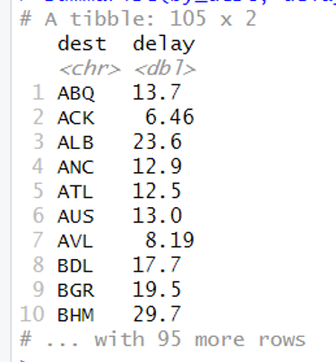
Using group_by function

Slide 31
11
Using combination of the functions

Slide 32
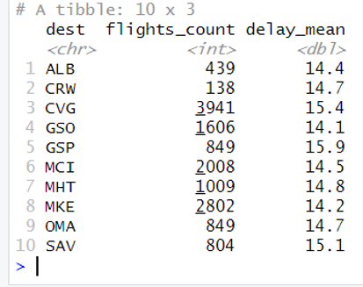
Using combination of the functions
flights %>%
group_by(dest) %>%
summarise(
flights_count = n(),
delay_mean = mean(arr_delay, na.rm = TRUE),
) %>%
filter(delay_mean > 14 & delay_mean < 16)

Slide 33
Quick Review

Slide 34
Learning outcomes
Summary of Main Teaching Points
Tibbles
Pipes
dplyr package
filter function
select function
arrange function
mutate function
summarise function
group_by function
Using combination of these functions
You are able to solve most data manipulation challenges.

Slide 35
Further reading materials:
https://r4ds.had.co.nz/exploratory-data-analysis.html

Slide 36
Question and Answer Session
Q & A
Book consultation slots for assistance.

Slide 37
Next Session
More Examples

